Slide 1
Natural Language Processing

Slide 2
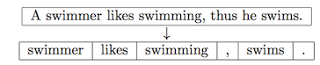
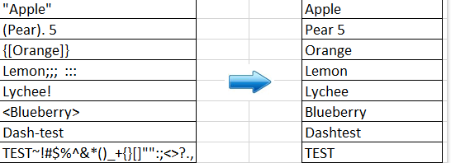
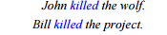
Text Preprocessing
Text Preprocessing
Stopwords Removal
Noise Removal
Object Standardization
Word Sense Disambiguation
some extremely common words which would appear to be of little value in helping select documents matching a user need are excluded from the vocabulary entirely.
Text data often contains words or phrases which are not present in any standard lexical dictionaries. These pieces are not recognized by search engines and models.
E.g.:'rt':'Retweet', 'dm':'direct message', "awsm" : "awesome", "luv" :"love",
Identify the sense of content words (noun, verb, adjective) in context (assuming a fixed inventory of word senses) i.e. when a word has more than one possible meanings

Slide 3
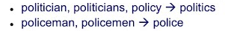
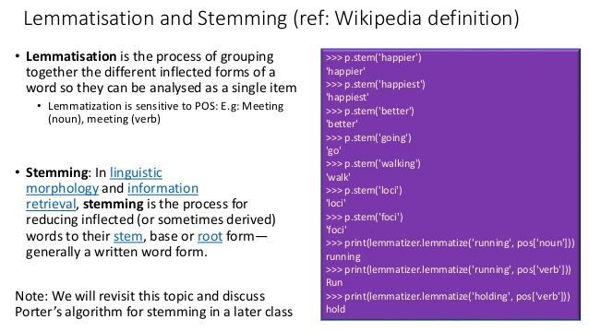
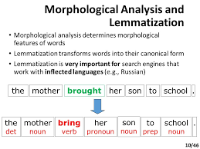
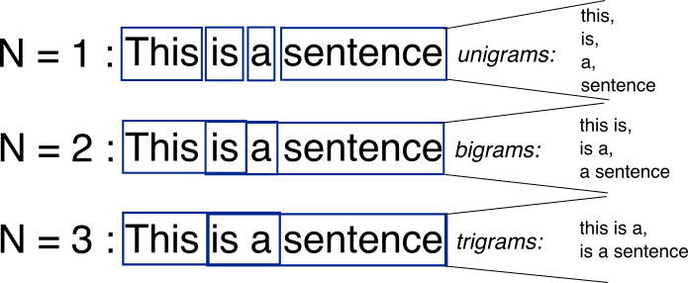
Text Preprocessing – (contd)
Text Preprocessing
Lexicon Normalization
Stemming
Lemmatization
N-Grams
Reduce words forms to popular form
Algo: Porter stemming
Wordnet dictionaries

Slide 4
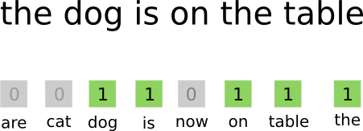
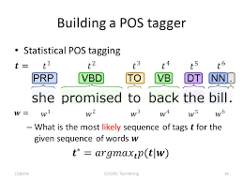
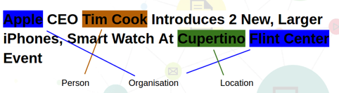


Text to Features
Text to Features
Bag of Words
POS Tagging
Named Entity Recognition
Viterbi algorithm
linear chain Conditional Random Field (CRF) sequence models
HMM Model
Classification
Classification
Summarization
Summarization
NLU

Slide 5
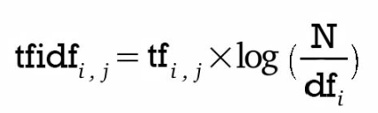
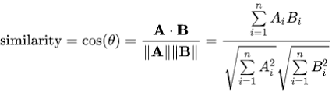

Text to Features– (contd)
Text to Features
TF – IDF
Cosine Similarity
tf–idf or TFIDF, short for term frequency–inverse document frequency, is a numerical statistic that is intended to reflect how important a word is to a document in a collection or corpus.
Cosine similarity is a measure of similarity between two non-zero vectors of an inner product space that measures the cosine of the angle between them. Thecosine of 0° is 1, and it is less than 1 for any other angle in the interval [0,2π).
Classification
Question and Answering

Slide 6
Appendix

Slide 7
R Packages for Text mining
tm provides a comprehensive text mining framework for R. The Journal of Statistical Software article Text Mining Infrastructure in R gives a detailed overview and presents techniques for count-based analysis methods, text clustering, text classification and string kernels.
openNLP provides an R interface to OpenNLP , a collection of natural language processing tools including a sentence detector, tokenizer, pos-tagger, shallow and full syntactic parser, and named-entity detector, using the Maxent Java package for training and using maximum entropy models.
RWeka is a interface to Weka which is a collection of machine learning algorithms for data mining tasks written in Java. Especially useful in the context of natural language processing is its functionality for tokenization and stemming.
wordnet provides an R interface to WordNet , a large lexical database of English.
tesseract is an OCR engine with unicode (UTF-8) support that can recognize over 100 languages out of the box.
lsa provides routines for performing a latent semantic analysis with R.
topicmodels provides an interface to the C code for Latent Dirichlet Allocation (LDA) models and Correlated Topics Models (CTM) by David M. Blei and co-authors and the C++ code for fitting LDA models using Gibbs sampling by Xuan-Hieu Phan and co-authors.
lda implements Latent Dirichlet Allocation and related models similar to LSA and topicmodels.
stm (Structural Topic Model) implements a topic model derivate that can include document-level meta-data. The package also includes tools for model selection, visualization, and estimation of topic-covariate regressions.
RTextTools is a machine learning package for automatic text classification. It implements the nine different algorithms (svm, slda, boosting, bagging, rf, glmnet, tree, nnet, and maxent) and routines supporting the evaluation of accuracy.
text2vec provides tools for text vectorization, topic modeling (LDA, LSA), word embeddings (GloVe), and similarities

Slide 8
Python Packages for Text mining
The Natural Language Toolkit, or more commonly NLTK, is a suite of libraries and programs for symbolic and statistical natural language processing (NLP) for English written in the Python programming language.
Gensim is a robust open-source vector space modeling and topic modeling toolkit implemented in Python. It uses NumPy, SciPy and optionally Cython for performance. Gensim is specifically designed to handle large text collections, using data streaming and efficient incremental algorithms, which differentiates it from most other scientific software packages that only target batch and in-memory processing.
spaCy is an open-source software library for advanced Natural Language Processing, written in the programming languages Python and Cython. It offers the fastest syntactic parser in the world.^{[2][3][4]} The library is published under the MIT license and currently offers statistical neural network models for English, German, Spanish, Portuguese, French, Italian, Dutch and multi-language NER, as well as tokenization for various other languages.

